Slide 1


Slide 2

بنام خدا
دانشكده فني وحرفه اي شهيد رجايي لاهيجان
درس زبان فني حسابداري
مدرس :پورحسيني
جلسه اول :صورتهاي مالي اساسي
Unit one: The principal financial statements

Slide 3
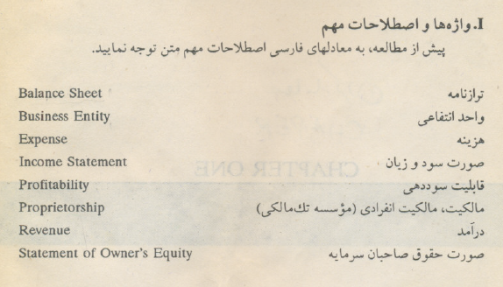

Slide 4
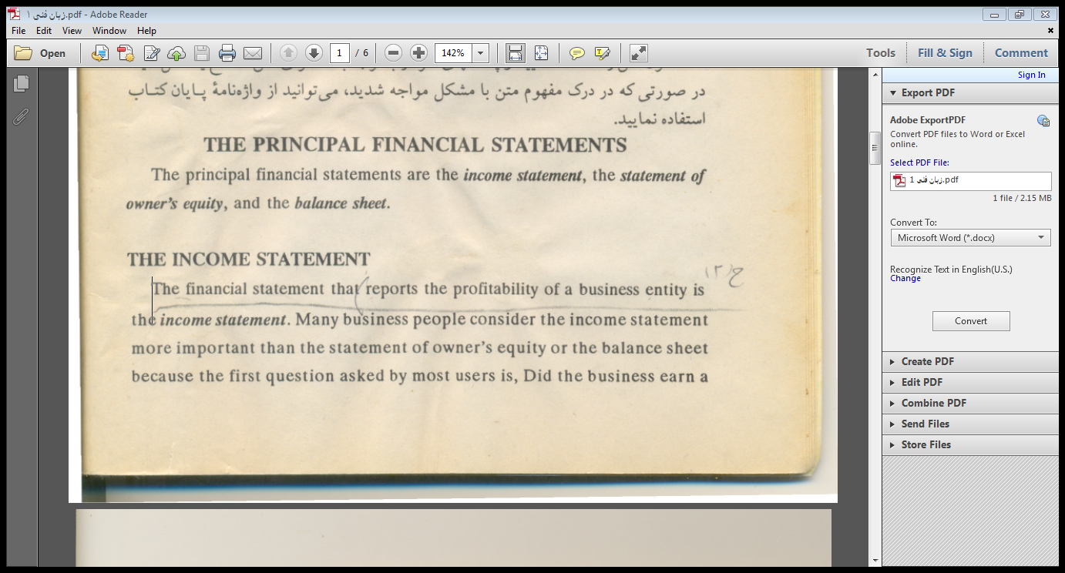
The principal financial statements are the income statement, the statement of
owner's equity, and the balance sheet
THE INCOME STATEMEN'
profit? The answer to that question can be found on an income statement.

Slide 5
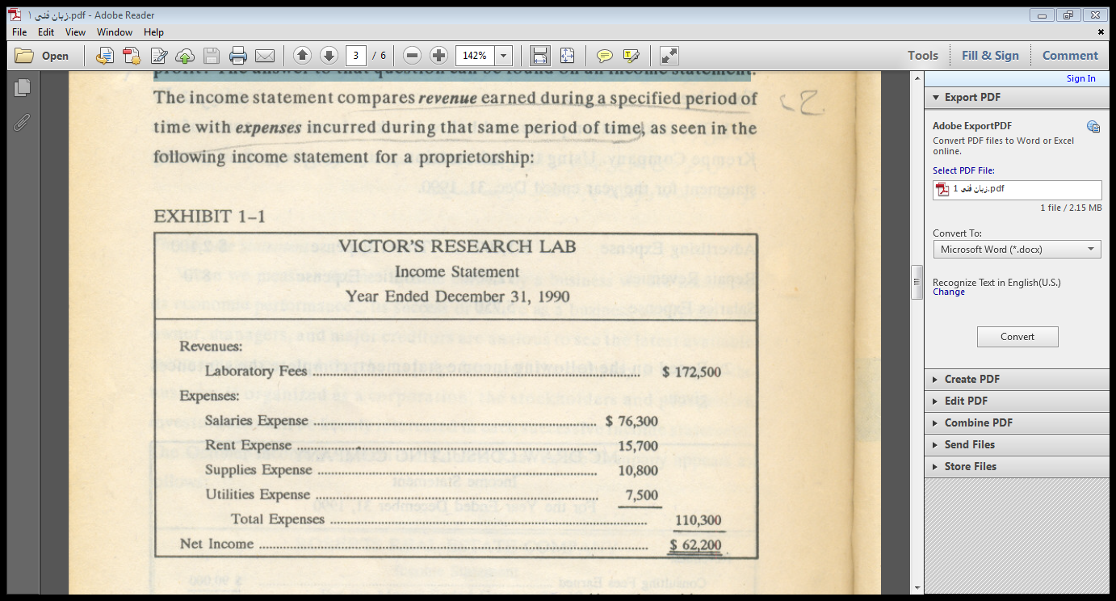

Slide 6
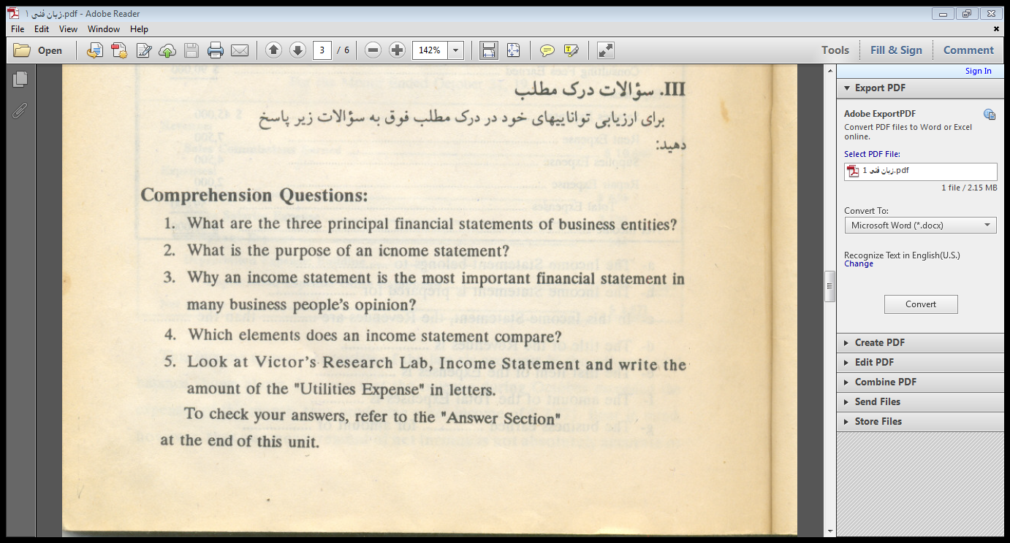

Slide 7
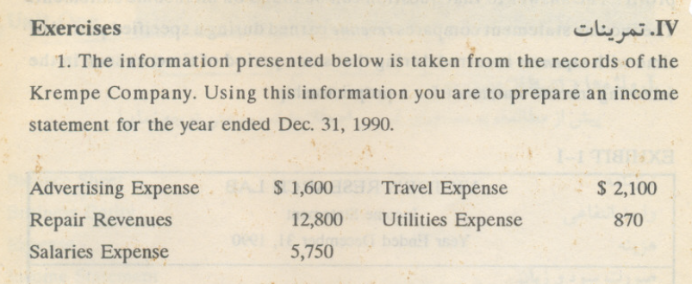

Slide 8
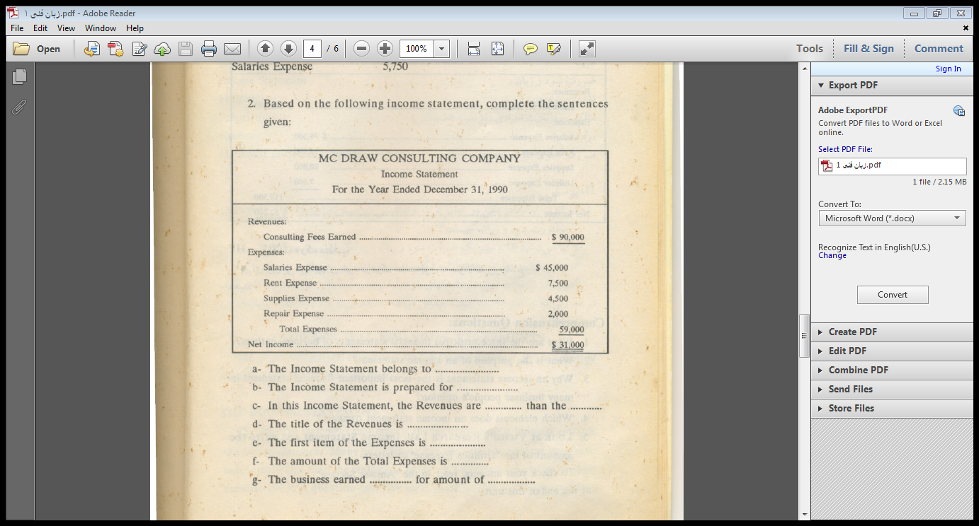

Slide 9
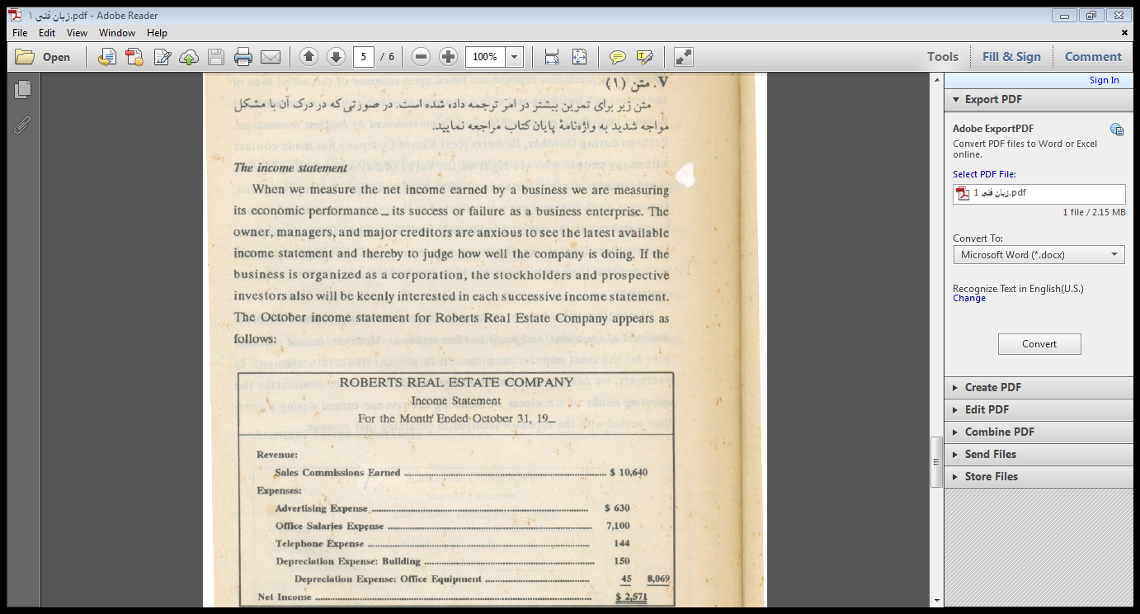

Slide 10
